Slide 1
Day 4 – Evaluating Few-shot learning

Slide 2
Day 3 recap
Few-shot on non-image modalities
Modality-specific encoders
Video
Activity recognition
Audio
Audio event detection
Text
Authorship attribution

Slide 3
Day 4 agenda
Baselining few-shot performance
Alternatives to few-shot learning
Generalization and better evaluation
Other considerations around bias
Practical Examples
Model fine-tuning

Slide 4
Few-shot Baselines

Slide 5
Model Evaluation
With the way support sets are sampled it wouldn't be good to just pick one and run all you test data against it. With that in mind we average the performance over multiple episodes
The shot and way define the problem and greatly effect model performance
Shot: The number of examples in you support set
Way: The number of classes you are trying to predict for
A 5-shot 5-way is an easier problem than a 1-shot 10-way problem

Slide 6
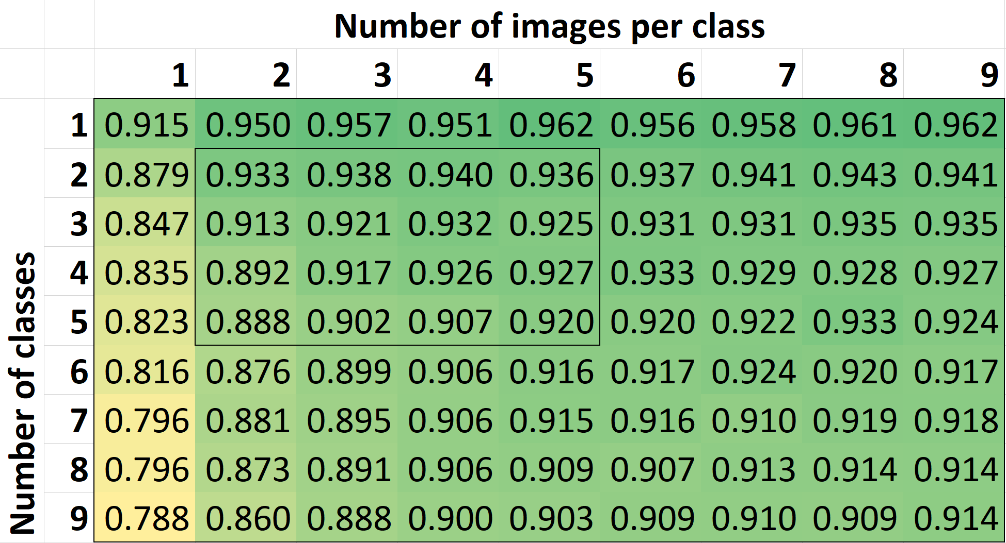
Model Evaluation
RCNet performance on ImageNet
800 classes for training
100 for val, 100 for test
Performance increases with more examples
Decreases as # of classes goes up

Slide 7
Evaluating Few-shot Models
Throughout the workshop, we’ve seen a variety of models and datasets. But is there a clear winner?
Comparing results of different approaches can be difficult for a variety of reasons
Different implementations
Different datasets / data splits
Transductive vs Non-transductive models
Combined, this makes it quite challenging to know what performance to expect on a new dataset, or which existing method will perform best

Slide 8
MiniImageNet
As an example, 5-shot, 5-way performance on MiniImageNet is the most reported performance metric in the academic literature
There are two train/test splits in common usage…
Is fine-tuning a good approach?
Maybe, but it also uses a bigger encoder…
Regardless, all of these models are trained on 84x84 pixel images
Not useful for real-world tasks
 | 5-shot, 5-way | Encoder | Transductive
MatchingNets | 60.0 | Conv (64)x4 | No
ProtoNets | 68.2 | Conv (64)x4 | No
MAML | 63.1 | Conv (32)x4 | Yes*
R2D2 | 68.4 | Conv (96)x4 | No
TADAM | 76.7 | Resnet-12 | No
Fine-tuning | 78.2 | WRN-28-10 | No
Transductive fine-tuning | 78.4 | WRN-28-10 | Yes
LEO | 77.6 | WRN-28-10 | Yes?
Not stated in paper
Results as reported in https://arxiv.org/pdf/1909.02729.pdf

Slide 9
Establishing a human baseline
These problems remain for almost all few-shot baselines
E.g. Metadataset also limits models to 84x84 pixel resolution
E.g. Kinetics video dataset has Kinetics 400, two versions of Kinetics 600…
Few papers consider the possibility that some images may belong to no class
The end result of this:
Few-shot models trained for real-world use can’t be directly compared against existing published results
Compare few-shot models against human baseline
How well could a human do the same task?

Slide 10
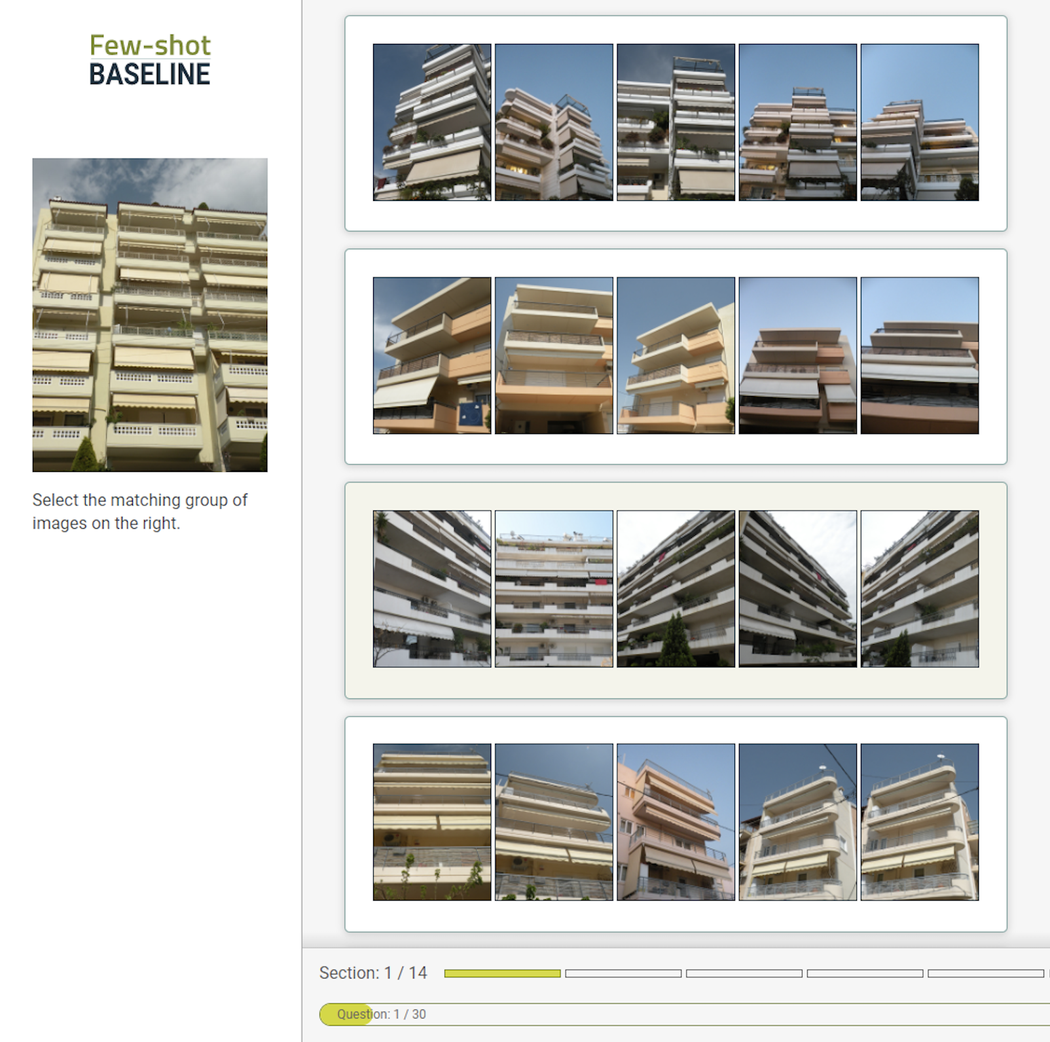
Baseline User Interface
Classes to choose from
Image to label

Slide 11
Results – By Dataset
Results for all participants (n=46)
On average, only 14.0%pt. gap between model and human accuracy, min. 3.8% gap
Accuracy depends heavily on dataset and is correlated with speed (r=-.113, p<<0.0001)
Model speed depends on compute available. On a single P100 GPU = 0.07 seconds per decision
Dataset | RCNet Accuracy (%) | Human Accuracy (%) | Human speed (seconds)
ImageNet | 88.9 | 95.1 | 6.4
miniImageNet | 83.3 | 92.0 | 7.6
FGVC Aircraft | 60.3 | 64.1 | 17.3
Describable Textures | 60.9 | 82.6 | 7.9
Fruits 360 | 82.8 | 96.8 | 5.8
Urban Buildings | 67.5 | 85.0 | 15.0
Adience Faces | 45.5 | 71.4 | 12.6

Slide 12
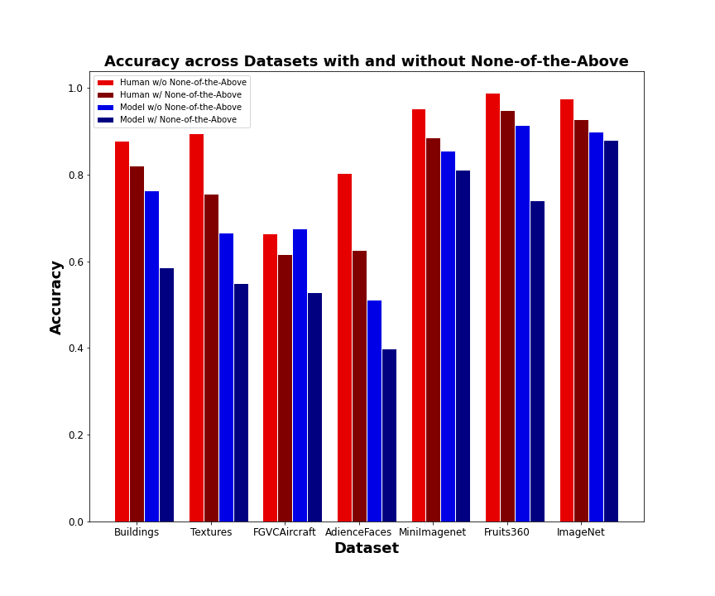
Results – None-of-the-above
Inclusion of none-of-the-above images decreases performance by 8.2%pts for participants and 11.3%pts for the model
Pattern is consistent across datasets

Slide 13
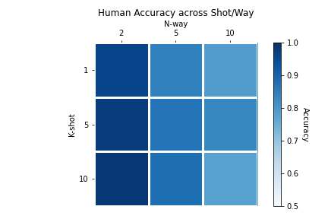
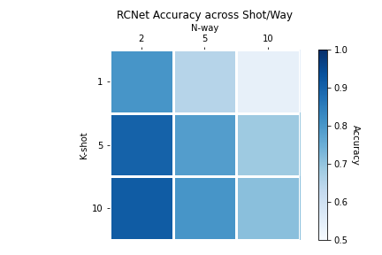
Results – Shot/Way Combinations
Humans perform worse as the number of classes increases (n-shot)
Model performs worse with more classes and fewer examples

Slide 14
Alternatives to Few-Shot Learning
Notes:
When to use it, when not to use it
Simple-shot
Transformers in a few-shot context
Transfer learning

Slide 15
What is Transfer Learning?
Transfer Learning is the practice of leveraging a prior-trained network for a new task or domain
Why does this work?
Most CNNs show the same type of early features
The layers near the output are tightly coupled with the task
We want to exploit the generalizability of the early layers

Slide 16
Transfer Learning
Benefits:
Spreads the benefit of state of the art research to the masses
Jumpstart training for a difficult problem
Reduce overfitting on a small data set
Common scenarios for Transfer Learning:
Task Transfer: Have a model trained to identify dogs and cats, need a new one to detect horses and cows
Domain Transfer: Have an image classifier trained on professional photographs, need a model that runs on cell phone image data

Slide 17
Model Fine-tuning Considerations
Things to keep in mind:
What type of transfer learning are you doing (domain or task)?
How much data do you have?
How similar is the target problem from the source problem?
Typically, fine-tuning is much faster than training from scratch
~1-5 epochs instead of 20+
If your fine-tuning dataset is small, you can train too much -> overfitting
Overfitting is the bane of few-shot learning. If your model overfits to the point it does poorly on new images for old classes, how can it do well on entirely new classes?
Notes:
Rework

Slide 18
Transfer learning as few-shot learning
A straight-forward approach might be to train a network on the few-shot training data as a traditional classifier, and then fine-tune on the support set.
Unfortunately, for small data this technique seems to perform poorly (Vinyals et al., 2016; Chen et al., 2018)
But transfer learning can potentially become competitive when applied carefully (Chen et al., 2018; Dhillon et al., 2020)
Notes:
Vinyals et al 2016: https://arxiv.org/pdf/1606.04080.pdf
Chen et al 2018: https://arxiv.org/pdf/1904.04232.pdf
Dhillon et al., 2020: https://arxiv.org/pdf/1909.02729.pdf

Slide 19
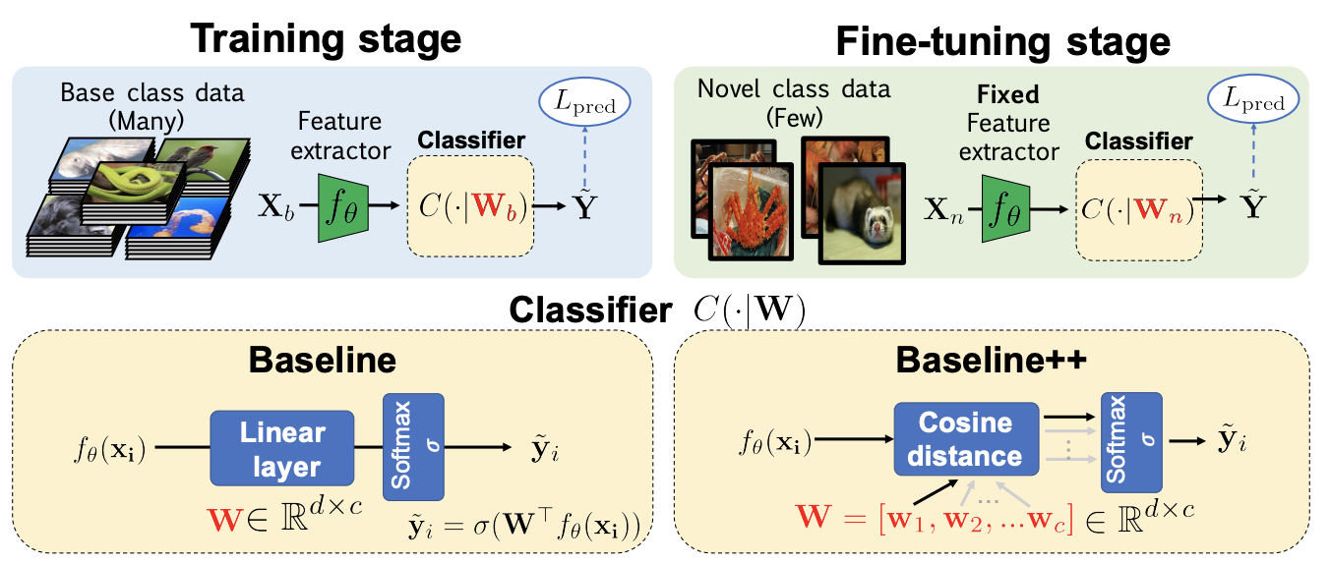
Baseline++
Baseline++ applies transfer learning to a few-shot scenario (Chen et al. 2018)
Modifications to standard transfer learning:
Fix encoder weights and do not update
Rely on cosine distance instead of traditional linear classifier
Fine-tune the weight vector for each class
Similar to prototypical networks
Matches similar level of performance to few-shot models on MiniImageNet
Figure 1 from https://arxiv.org/pdf/1904.04232.pdf

Slide 20
Transductive Fine-tuning (Dhillon et al., 2020)
Transductive models use all datapoints in the test set to make predictions
E.g. Allows semi-supervised techniques to be applied at test time
Modifications to standard transfer learning:
Cross-entropy loss is used on support examples, Shannon Entropy regularization applied to query examples
Transductive because it uses all queries to label a single query example
Initialize classifier weights and normalize model outputs to unit L2 norm
Maximizes cosine similarity between weights and encoder outputs
Use model logits as the input to final classification layer instead of penultimate layer’s features
Logits show better clustering behavior

Slide 21
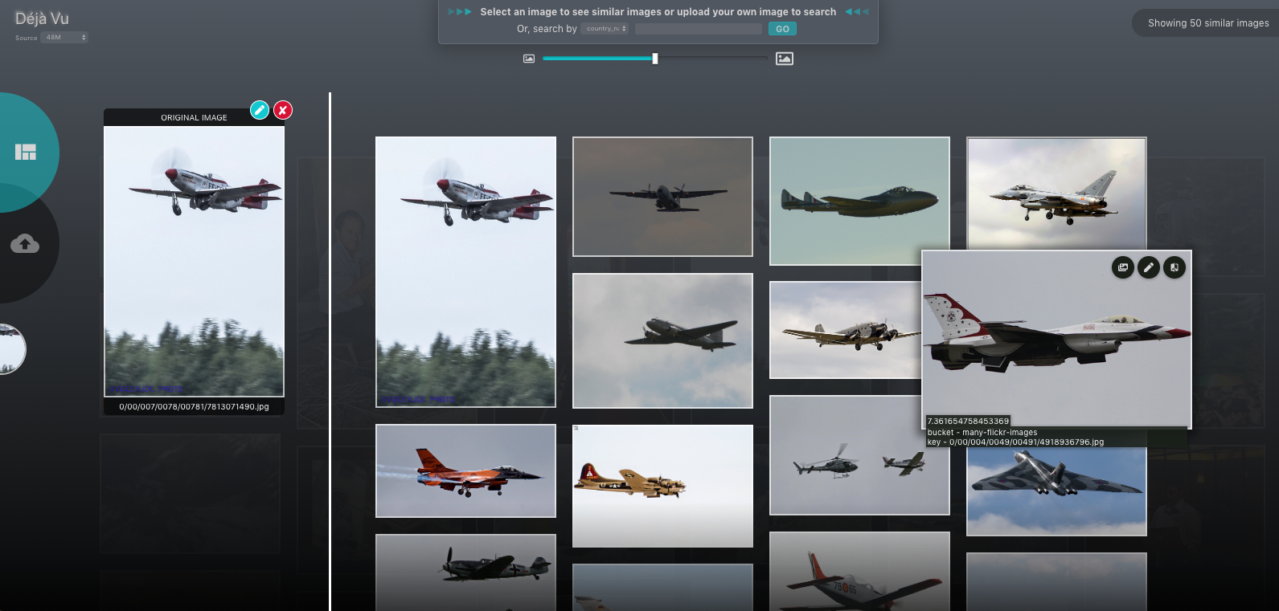
Information Retrieval vs Few-shot
Many information retrieval systems rely on calculating distances based on features extracted from a pretrained model
When to choose information retrieval
Only have a single example
It’s a quick way to look through a larger dataset
When to choose few-shot learning
Have multiple images you’d like to leverage, or multiple classes to choose from
Need to generalize beyond training dataset

Slide 22
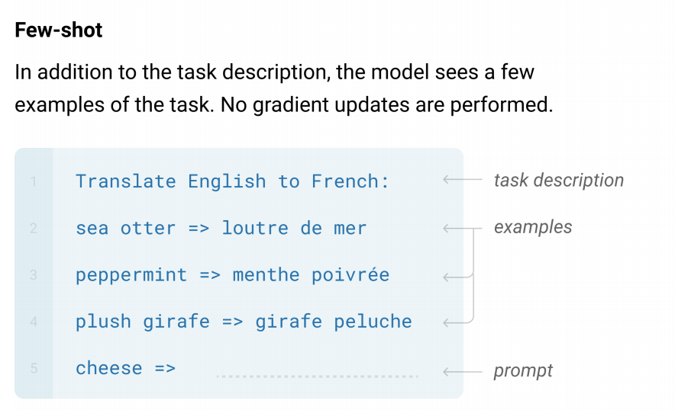
GPT-3 - Language Models are Few-shot Learners
Alternatively, in some cases pre-trained models may work for few-shot without modification…
For large language models, support examples can be provided as context
This trend to ever larger models has been stronger in NLP than other domains
Large training datasets have their own concerns, especially around bias
https://arxiv.org/pdf/2005.14165.pdf

Slide 23
More on Evaluation & Generalization

Slide 24
Evaluating few-shot generalization
As performance on individual image datasets has begun to plateau, the field has moved towards better assessments of generalization
How can we understand when few-shot models generalize to a new class (or don’t?)
What if a specific type of class is absent from training?
Challenge test sets
What if the type of class is very different from the training data?
Meta-dataset

Slide 25
Distributions of classes
To understand where a few-shot model will perform well, we have to understand what defines a class during training
Performance will be best when test classes mirror training classes
Simply put, classes are defined by our labels:
ImageNet: class = object identity (e.g. dog, cat, plane, train, etc.)
VisualGenome: class = object identity (for specific region of image)
Describable Textures: class = texture of object
Kinetics 600: class = human activity in video
Reddit comments: class = authorship
If during inference, we change the definition of what makes up a class, performance will degrade

Slide 26
An example – Sorting cars by color
Model was trained on Stanford Cars dataset
Class determined by Make/Model/Year
Color represents an “out-of-distribution task” in that it does not follow the same pattern used to create classes for training
In fact, color may be largely ignored by the model since any make/model/year may have any number of different colors.

Slide 27
Challenge Test Sets
What happens when few-shot models generalize to a category that doesn’t exist in the training data?
Traditionally, deep learning has performed poorly in these scenarios
Easy Test set
Hard Test set

Slide 28
Challenge Test Sets - SCAN
SCAN is a non-fewshot dataset which demands out-of-distribution generalization (Lake & Baroni, 2018)
Sequence-to-sequence task: Text command -> ACTION
“Jump left” -> LTURN JUMP
”Jump opposite left and walk thrice” -> LTURN LTURN JUMP WALK WALK WALK
Easy test set: A random set of commands are withheld
100% accuracy even when trained on only 8% of all combinations of commands
Hard test set: Sees all primitives, but never the combination “turn left”
LSTM-based seq2seq = 90.3% accuracy

Slide 29
Challenge Test Sets - SCAN
But “turn left” is very similar to “turn right”. “Jump” follows the same pattern as “walk” and “run”, but shows different generalization performance
2nd Hard test set: Sees all primitives, but never “jump” in combination
LSTM-based seq2seq = 1.2% accuracy (Lake & Baroni, 2018)
LSTM + Syntactic Attention = 78.4% (Russin et al., 2019)
Seq2seq + meta-training = 99.95% (Lake, 2019)
What is meta-training?
Same support/query structure as used in few-shot learning
Notes:
Jake Russin, Jason Jo, Randall C. O’Reilly, and Yoshua Bengio. Compositional generalization in a deep seq2seq model by separating syntax and semantics. arXiv preprint, 2019. URL http://arxiv.org/abs/1904.09708.
Lake, B. M. (2019). Compositional generalization through meta sequence-to-sequence learning. In Advances in Neural Information Processing Systems (pp. 9791-9801).
Chicago

Slide 30
Challenge Test sets
Matching Networks (Vinyals et al., 2016)
Early few-shot learning model, introduced MiniImageNet
Trained two few-shot models on ImageNet.
The first had a random train/test split
The second was trained on all non-dog categories and evaluated on all dog categories
Even for few-shot models, this can be a challenging task
 | Random split | Dogs Split
Train | 97.0% | 96.4%
Test | 93.2% | 58.8%
Notes:
LAP: Could split this into multiple slides to highlight results from each test set. Not sure if we go into detail on easy/hard splits on Day 3

Slide 31
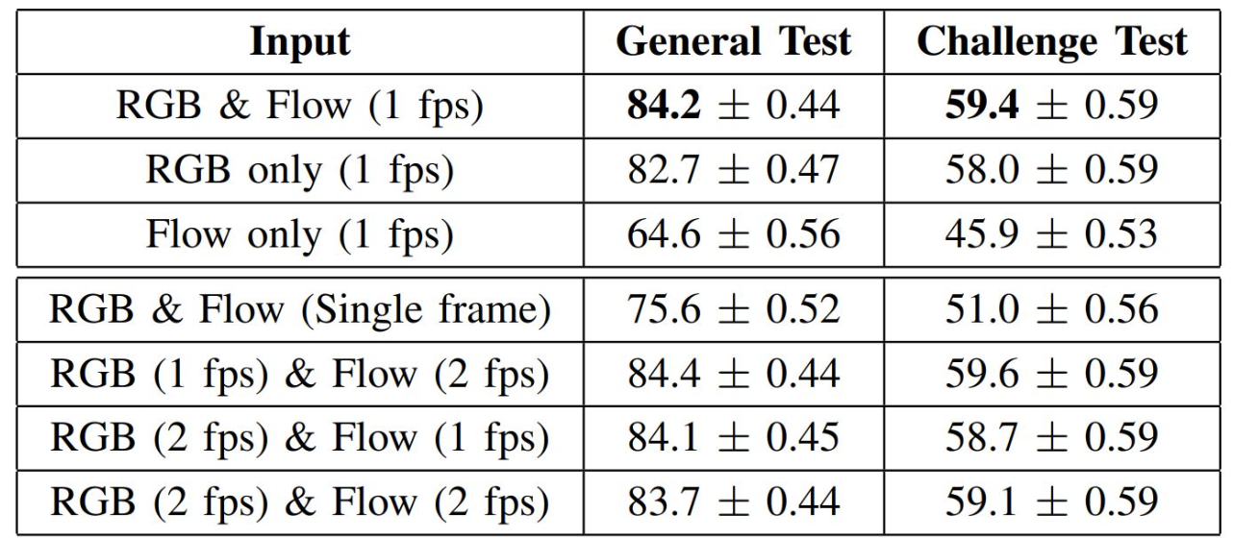
Challenge Test Sets
Kinetics 600
Challenge test set is made up of “violent” actions
See similar performance drop
Reddit authorship
“Hard” test set is made up of users who post on a very diverse set of subreddits
Intended to capture whether the model “solves” authorship by recognizing most authors tend to write on a small set of topics
 | Easy | Hard
DistilBERT | 83.2% | 61.3%
All Stylometrics | 67.3% | 52.0%
All + DistilBERT | 83.8% | 61.8%
Notes:
Kinetics 600 results from work done by Chris Careaga and Brian Hutchinson

Slide 32
Meta-Dataset (& other meta-datasets)
Introduced in Triantafillou et al. (2020), Meta-dataset is a few-shot dataset made up of 10 different few-shot datasets
Train on 8 datasets, test on 2 held-out datsets
Speaking of distributions…
Traditional deep learning generalizes to new examples of known classes
Few-shot generalizes to new examples of unknown classes
Meta-dataset generalizes to new examples of unknown classes from unknown datasets!
Training datasets |  | Validation datasets
ImageNet | Quick Draw | Traffic Signs
Omniglot | Fungi | MSCOCO
FGVC Aircraft | VGG Flower
CUB Birds | Describable Textures

Slide 33
Bias and Ethics Considerations

Slide 34
Large Dataset challenges
What are potential harms and injustices?
People’s images are constantly mined without any real consent.
ImageNet contains plenty of voyeuristic, non-consensual images.
Reverse image searching identities is not that difficult!
Many categories are themselves unethical and offensive.
80 Million Tiny Images has 10,000+ images of people categorized as slurs.
Are there counterbalances against these harms?
Reactive
Public outcry, legal action...
Proactive
Ethics boards, regulation...

Slide 35
Large Dataset challenges - Opaque Datasets
JFT-300M is a huge, effectively private image dataset.
Used in many celebrated papers (GANs, separable convolution, etc).
300M+ images across 18,000 categories.
Hard to find any details...
Open Images is an open subset of JFT-300M.
...and contains non-consensual images of children in swimwear.
Prabhu & Birhane (2020) provide an overview of large image datasets
https://arxiv.org/abs/2006.16923
What incentives encourage these types of datasets to exist?
What incentives could discourage their prevalence?

Slide 36
Large Dataset challenges – Introducing Bias
Training on large datasets often requires training on data from the internet
Major source of bias in text models
GPT-2 and GPT-3 both have known issues of bias based on gender, race, and other factors.
E.g. GPT-3 has difficulty writing about Muslims without referencing violence
Content warning for islamophobia: https://twitter.com/abidlabs/status/1291165311329341440

Slide 37
Solutions: Power Distribution
Who actually has a say in…
What categories and ontologies we construct?
How models are trained and evaluated?
How we hold people and groups accountable?
The answer is rarely “those most impacted by them”.
Avenues for shifting power...
Increased transparency and dataset auditing.
Facilitates outside review.
Ethics committees.
Reduces some burden on practitioners.
Others?

Slide 38
Small Dataset challenges
Ever-larger datasets have many known issues…
But small data can also pose challenges:
Instead of large-scale societal biases, small datasets may have biases introduced through data collection
If a model is asked to solve a problem based on very little information, it has to rely on other sources of information

Slide 39
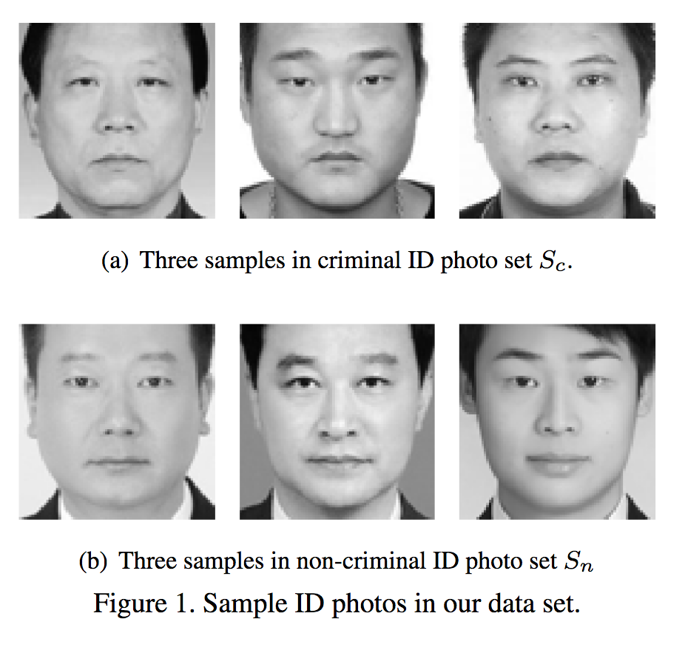
Small scale bias
When we ask models to do impossible things, we set ourselves up for our models to learn from biased datasets
Even small curated datasets can introduce bias
“Automated Inference on criminality using Face Images”
Wu & Zhang (2016)
Posted to ArXiv
89.51% Accuracy
Totally bogus results due to dataset
https://www.semanticscholar.org/paper/Automated-Inference-on-Criminality-using-Face-Wu-Zhang/1cd357b675a659413e8abf2eafad2a463272a85f

Slide 40
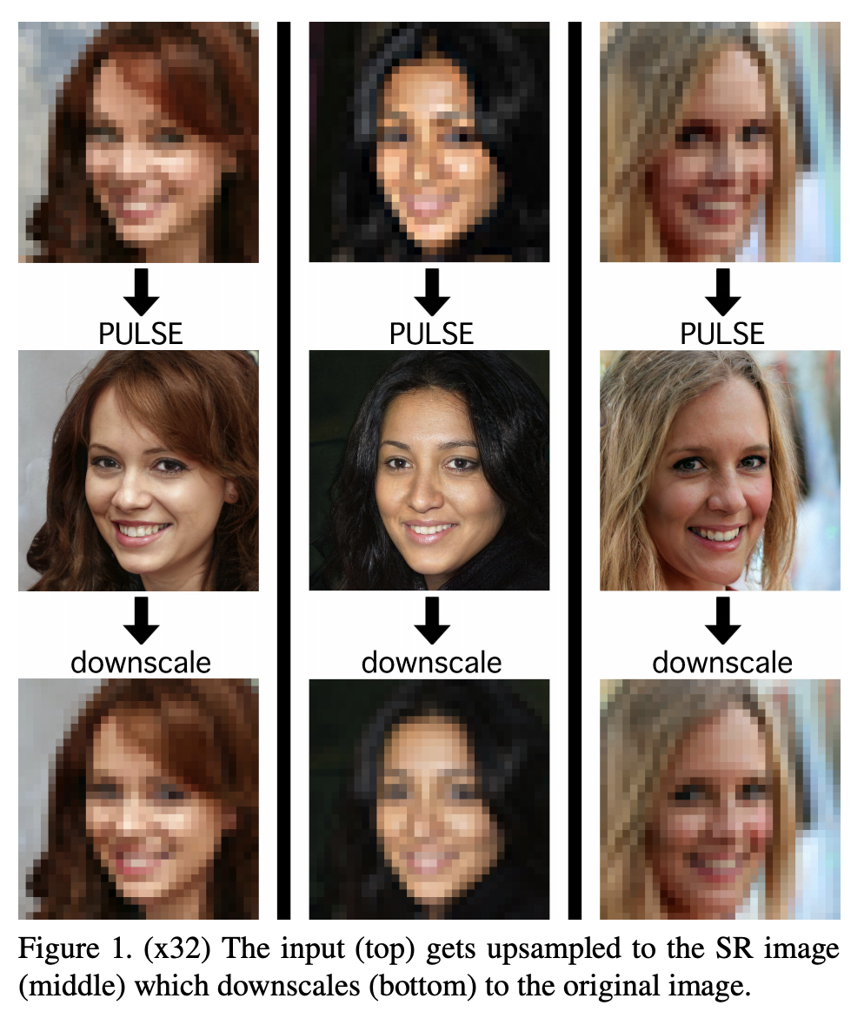
Low Information Tasks
PULSE: Self-Supervised Photo Upsampling via Latent Space Exploration of Generative Models
Original paper, https://arxiv.org/pdf/2003.03808.pdf
Code, https://github.com/adamian98/pulse
Leverages pre-trained model based on Flickr Face HQ Dataset
https://github.com/NVlabs/ffhq-dataset
Trained on CelebA HQ dataset
https://www.tensorflow.org/datasets/catalog/celeb_a_hq
https://arxiv.org/pdf/2003.03808.pdf

Slide 41
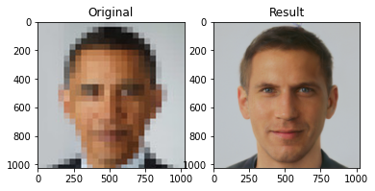
PULSE - Testing it out
Original Obama photo: https://www.biography.com/us-president/barack-obama Photo Credit: Pete Souza
Image went around on AI/ML Twitter
Notes:
Original Obama photo: https://www.biography.com/us-president/barack-obama Photo Credit: Pete Souza
Uncertain licensing, but this seems to be the photo that people started sharing on Twitter.

Slide 42
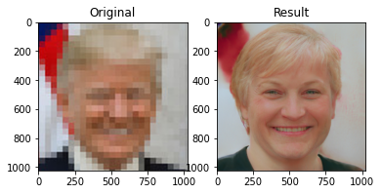
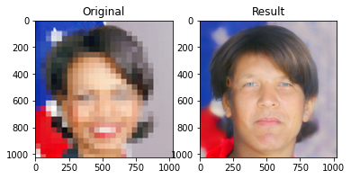
PULSE - Testing it out
Where did things go wrong?
Dataset biases
Pre-processing considerations
E.g. % of image taken up by face
Upscaling requires additional information not in input
In these cases, models are forced to rely on general patterns learned from data
“Good” vs “bad” bias difficult to separate
Notes:
Original Donald Trump photo: https://en.wikipedia.org/wiki/Donald_Trump
Public Domain usage rights, “President Donald Trump poses for his official portrait at The White House, in Washington, D.C., on Friday, October 6, 2017. (Official White House Photo by Shealah Craighead)”

Slide 43
Wrapping things up

Slide 44
Few-Shot Learning in Overview
Increasingly powerful approach to handling small data problems
The field is still young and no clear winner has emerged in terms of approach
Expanding how we think of and measure generalization (e.g. meta-dataset)
Can be applied to problems in a variety of data types
Image filtering, Authorship attribution, Activity recognition, Audio event detection
Influencing other fields
Transfer learning is improving based on ideas drawn from few-shot
Reinforcement learning has incorporated MAML-style meta-learning to reduce training times and improve generalization

